Slide 1
Housing Types and Forms in Pakistan-Climatic Base
Lecture - 4

Slide 2
Climatic Regions in Pakistan
Cold Composite
Cool Composite
Normal composite
Warm Composite
Extra dry Cool
Extra Dry Hot
Inland Maritime
Maritime
Reference: NRM pages 27-41

Slide 3
Climatic Regions in Pakistan

Slide 4
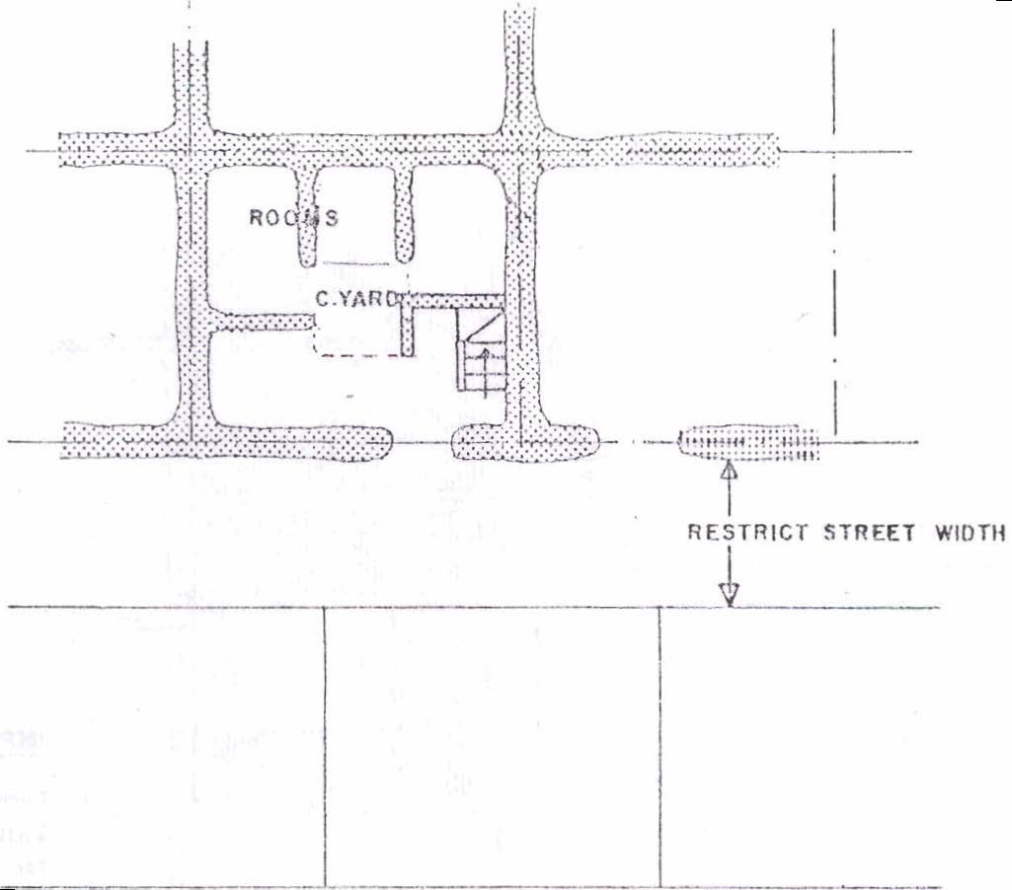
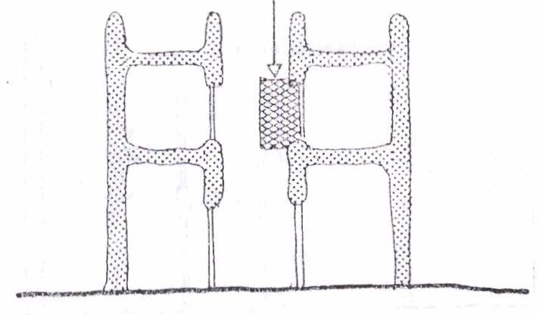
PLAN
Extra Dry Hot Climate
SECTION

Slide 5
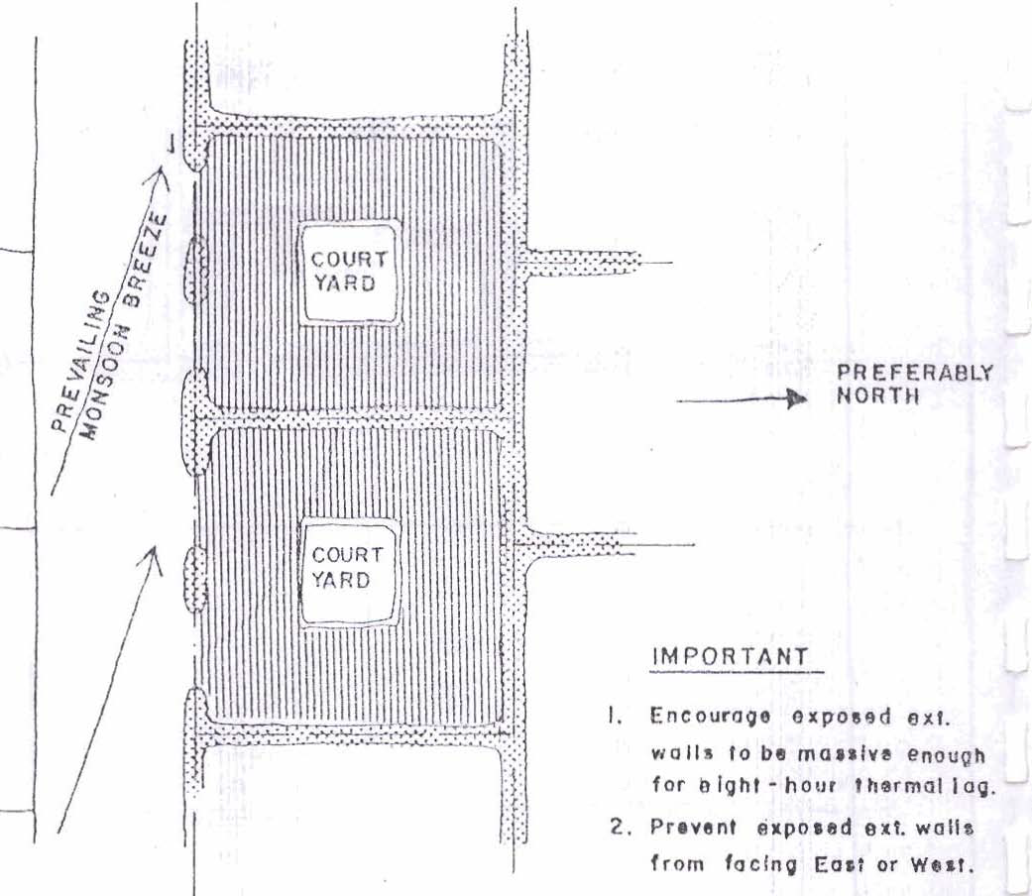
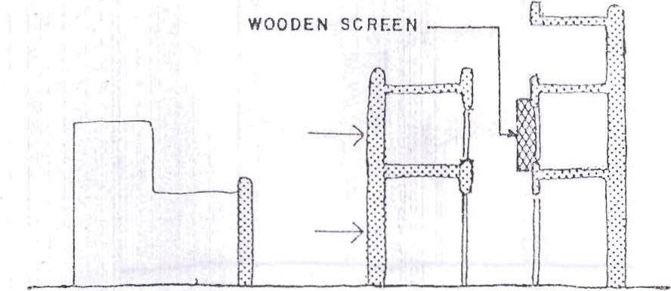
PLAN
Warm Composite Climate
SECTION

Slide 6
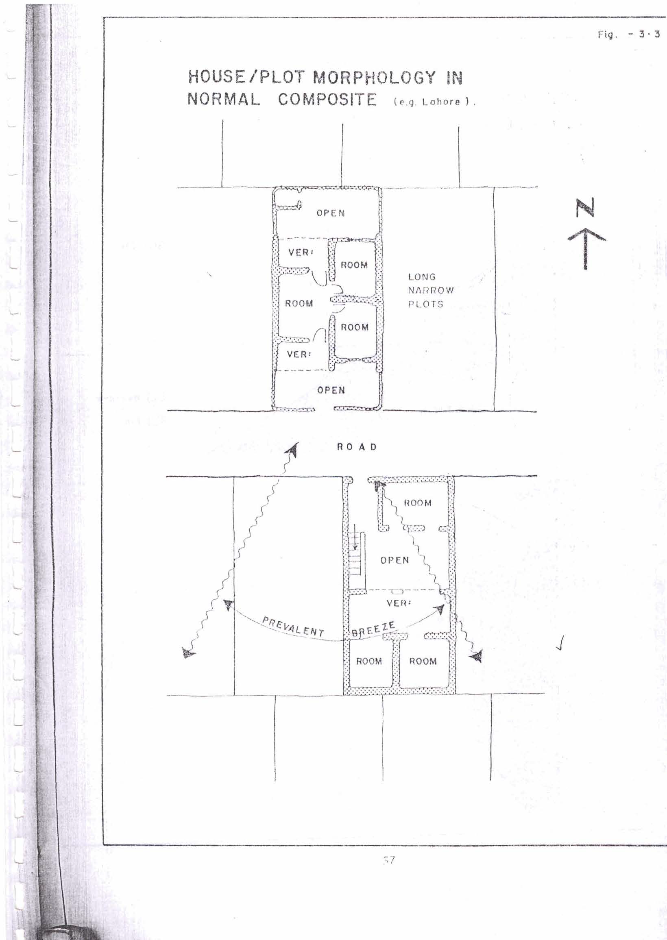
Normal Composite Climate
Lahore
PLAN
PLAN

Slide 7
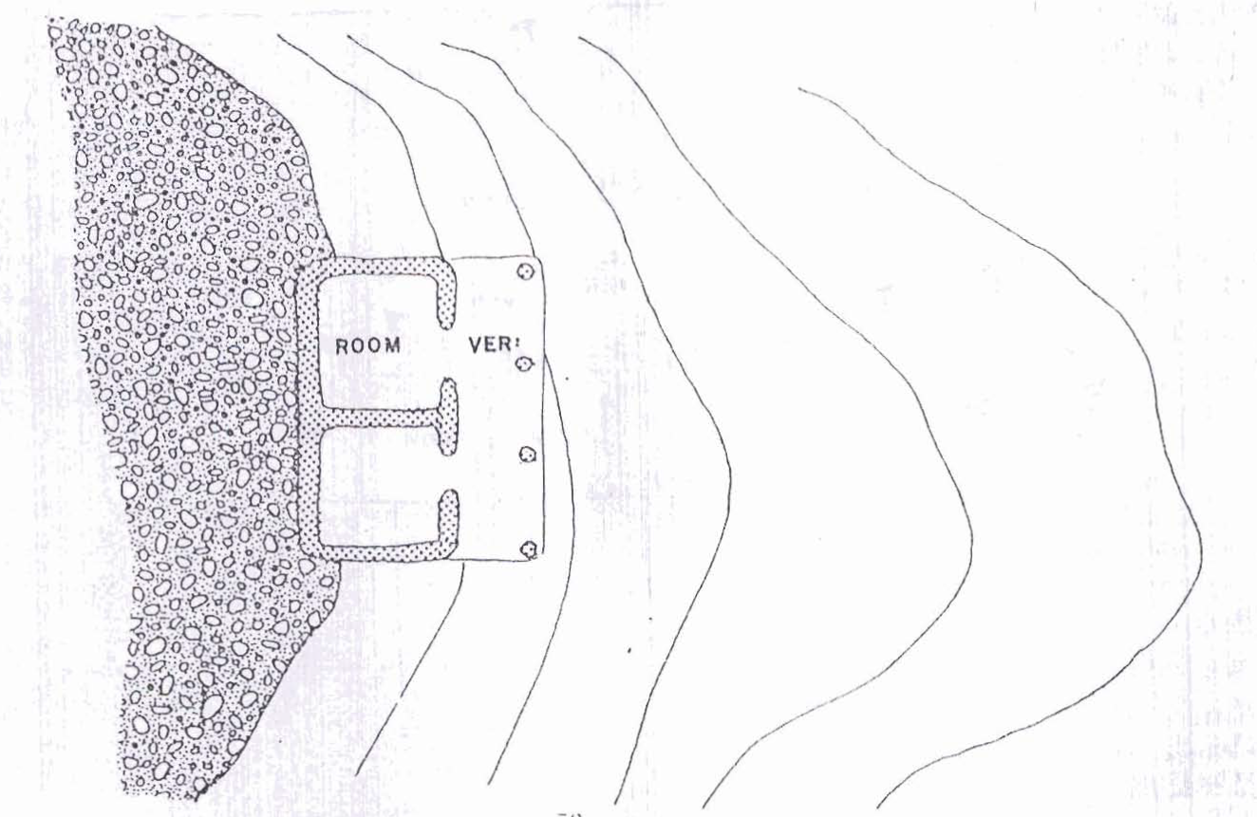
Cool/Cold Composite Climate
PLAN

Slide 8
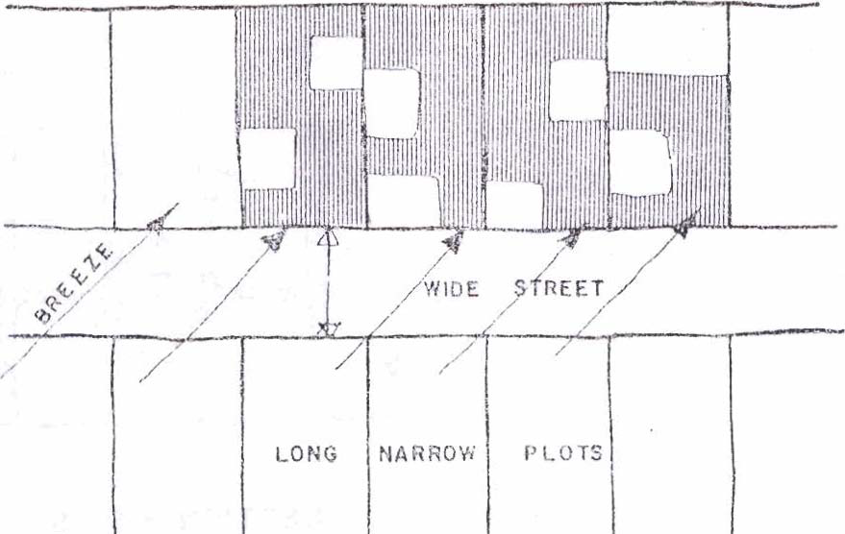
Maritime
Climate
PLAN

Slide 9
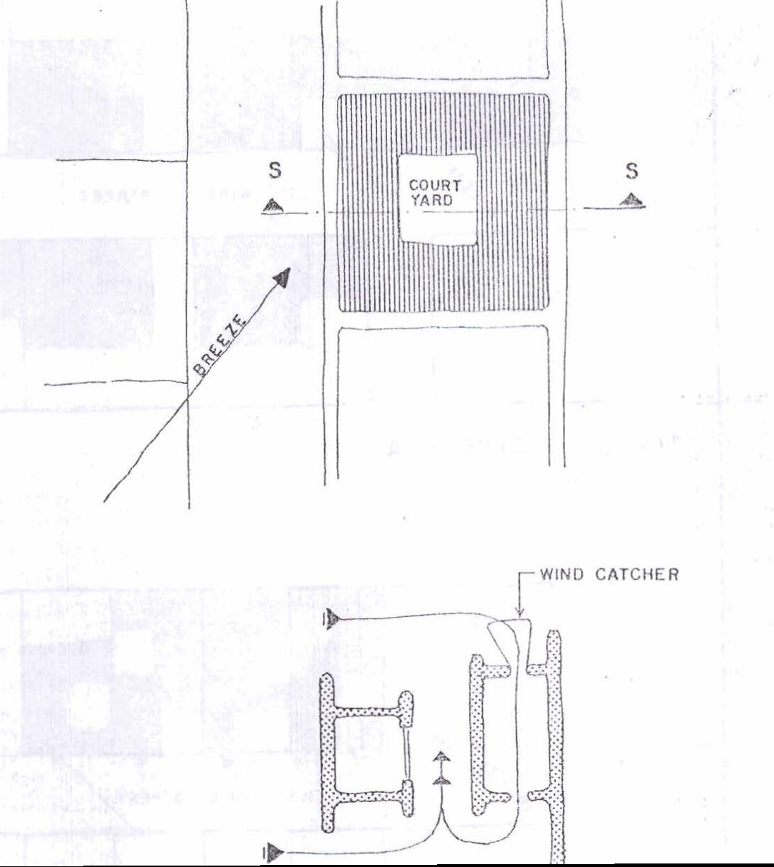
Inland Maritime
Climate
PLAN
SECTION

Slide 10
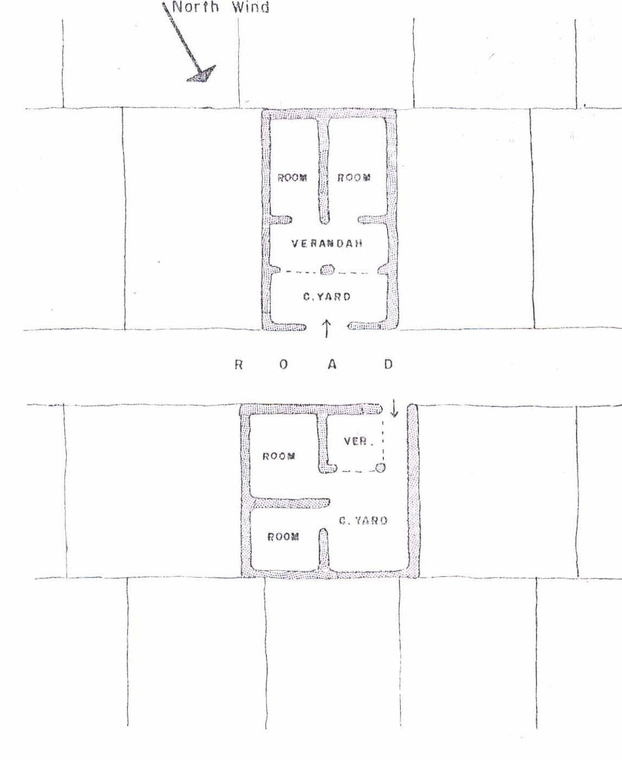
Extra Dry Cool
Climate
Quetta
PLAN
PLAN

Slide 11
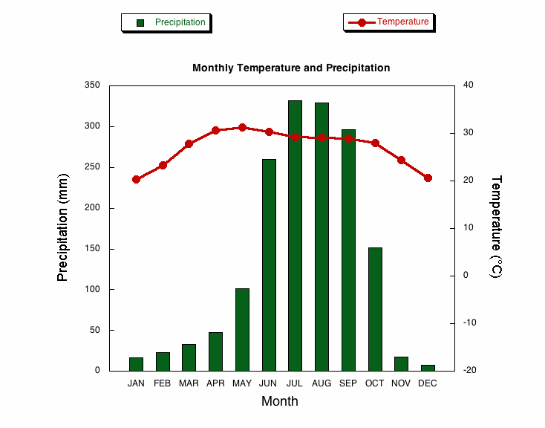
CLIMOGRAPH

Slide 12
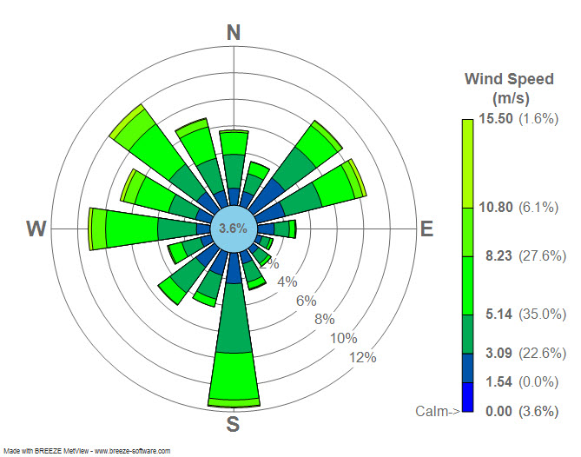
WIND ROSE DIAGRAM

Slide 13
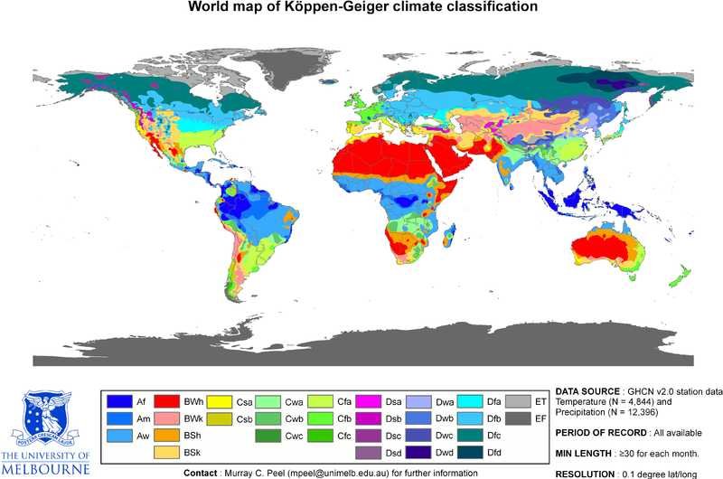

Slide 14
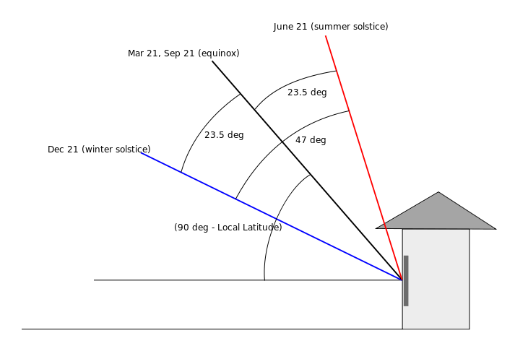
SUN PATH & SOLAR ALTITUDE

Slide 15
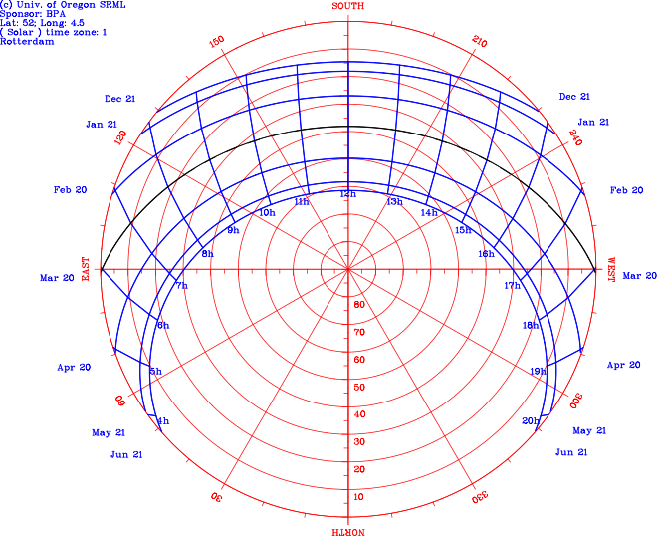
SUN PATH DIAGRAM

Slide 16
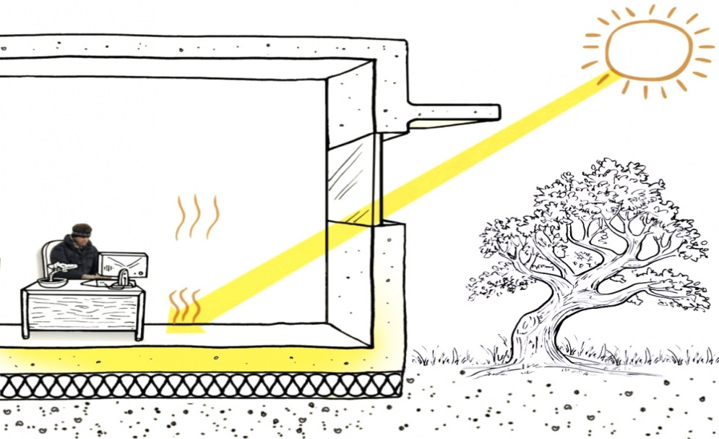

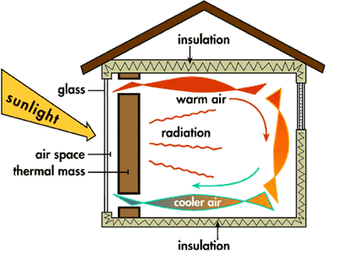
THERMAL MASS

